Slide 1

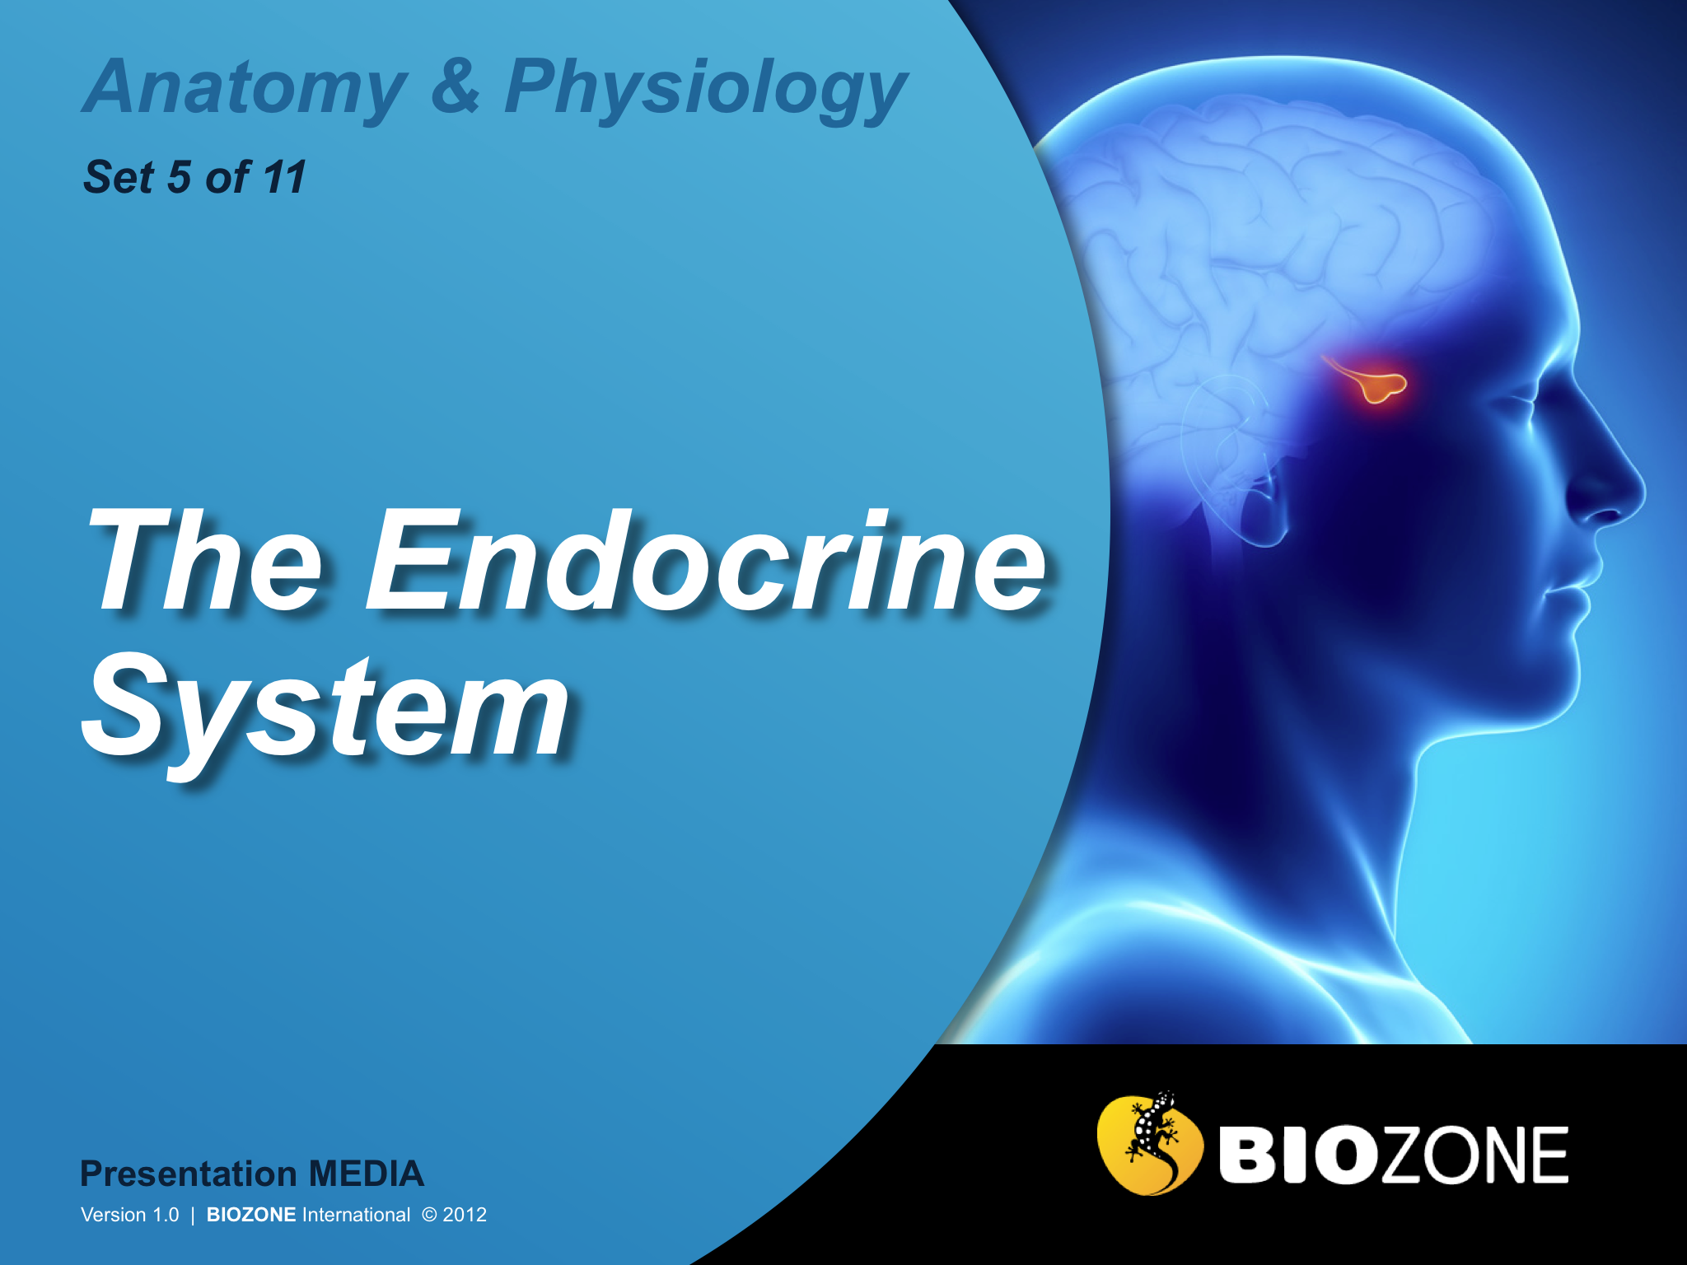

Slide 2
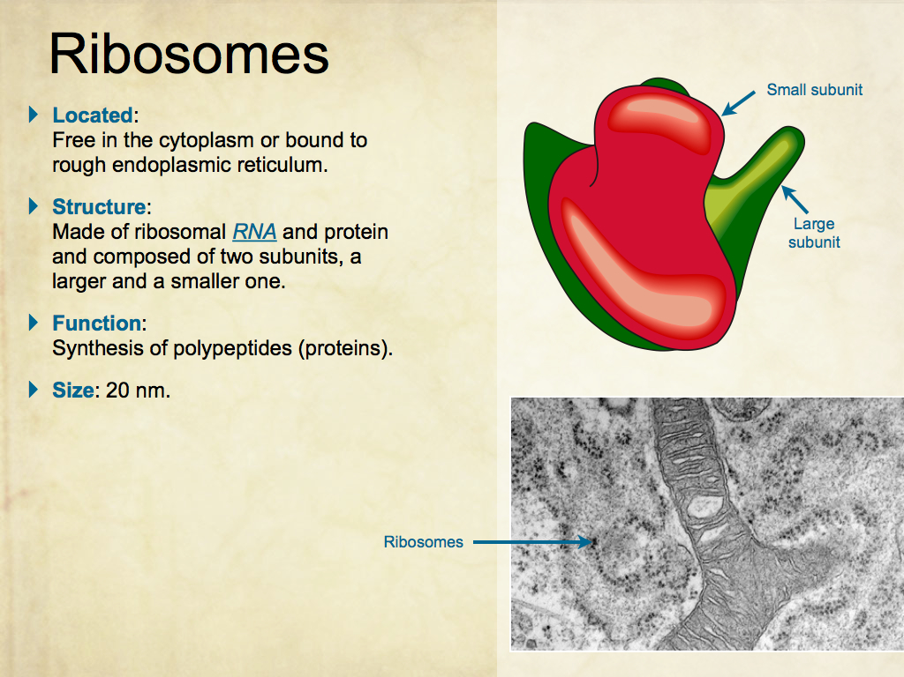
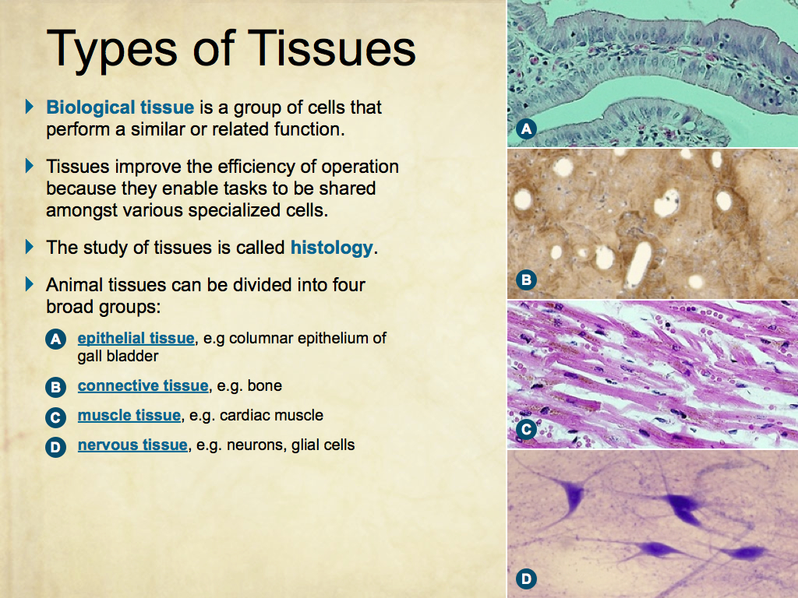
Using Presentation Media
BIOZONE Presentation Media
can be used either as a simple slide show or as an interactive lesson.
  Hyperlinks within the text take you to related slides.
Italicized hyperlinks link to the glossary of definitions.
Bold hyperlinks give direct access to specific slides.

Slide 3
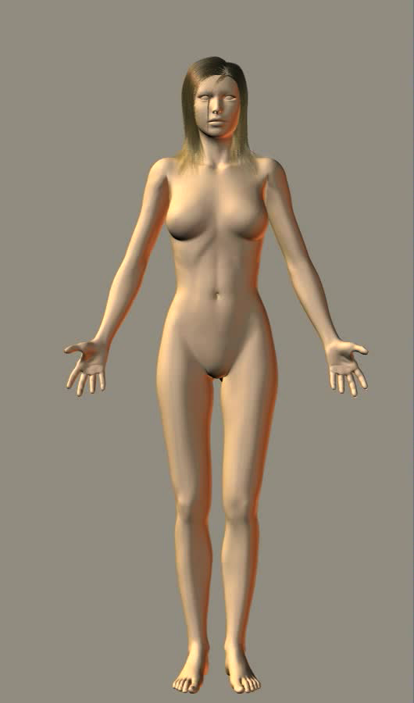
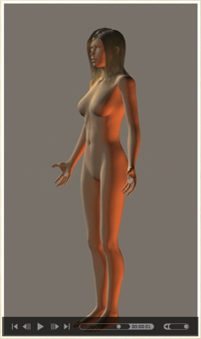
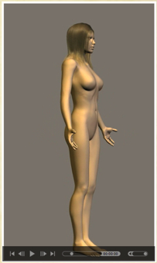
Using Presentation Media
BIOZONE Presentation Media can be used either as a simple slide show or as an interactive lesson
  The movie player allows you to rotate objects.
The movie loops continuously when activated
Use the movie controls in Keynote or Powerpoint
Pause the movie, then drag the slider to rotate the object back and forth

Slide 4
Introduction
  Interacting systems
  Contexts
Endocrine Glands
Endocrine Signaling
  Hormones
  Cell communication and recognition
Hypothalamus
  Role of the hypothalamus
  Hypothalamus structure
Stress Response
  Short term response
  Long term response
Hormones of the Pituitary
  Anterior pituitary
  Posterior pituitary
  Effects of Growth Hormone
Control of Blood Glucose
  Blood glucose vs insulin
  Blood glucose regulation
  Insulin signaling pathway
  Type 1 diabetes
Aging and the Endocrine System
  Changes with age
Glossary

Slide 5
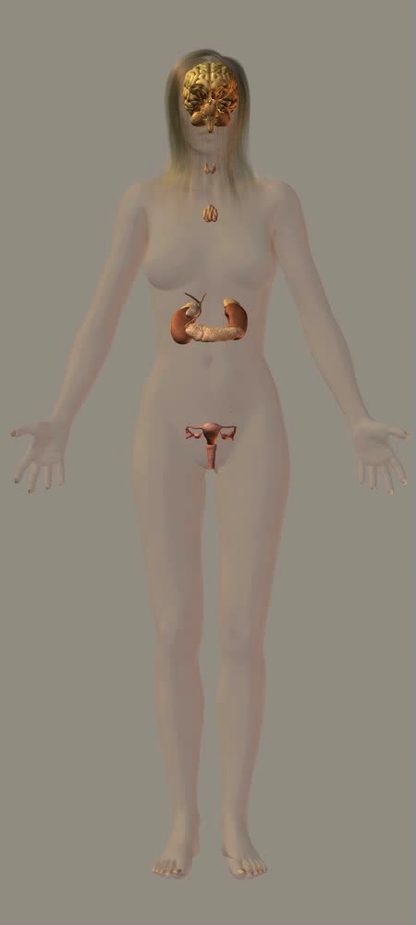
The Endocrine System
Endocrine glands are distributed throughout the body and are frequently associated with other organs of the body.
Endocrine organs are small in comparison to most other organs but their hormone secretions have wide ranging effects on the body by the production of hormones.

Slide 6
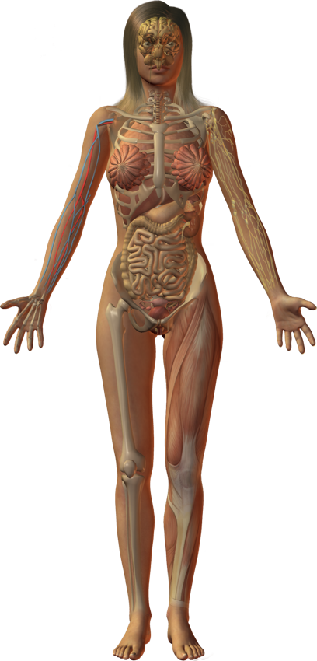
Interacting Systems
Nervous system
Cardiovascular system
Respiratory system
Lymphatic system and immunity
The endocrine system produces hormones that activate and regulate homeostatic functions, growth, and development.
Endocrine organs are small and found widely spaced through the body.
Both positive and negative feedback loops are important in the functioning of the endocrine system.
  Negative feedback is important in regulating endocrine function, but positive feedback also operates in some instances (e.g.childbirth).
The interactions of the endocrine system with other systems are described on the following slides.
Digestive system
Urinary system
Reproductive system
Integumentary system
Skeletal system
Muscular system

Slide 7
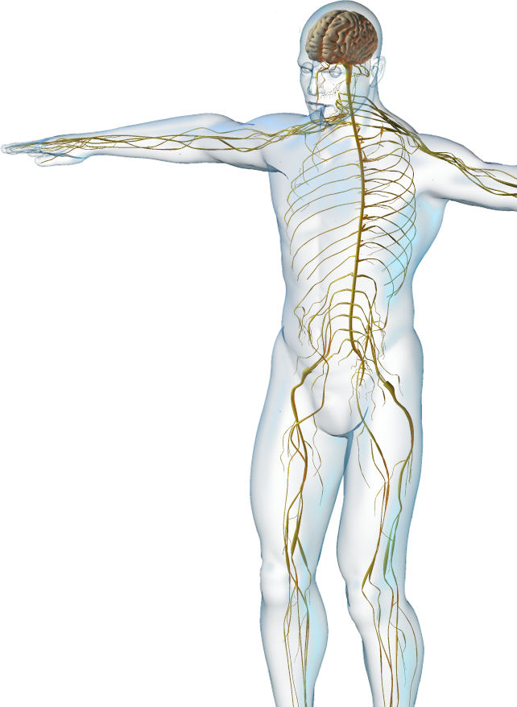

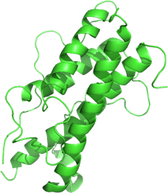
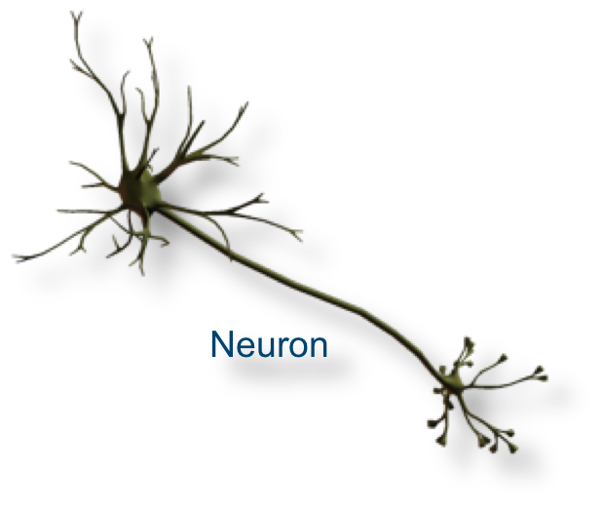
Nervous System
The endocrine system interacts with the nervous system:
  Many hormones produced by the endocrine system (e.g. growth hormone) influence the development of the nervous system.
  The hypothalamus controls the activity of the anterior pituitary gland and produces two important neurohormones)
Growth hormone

Slide 8
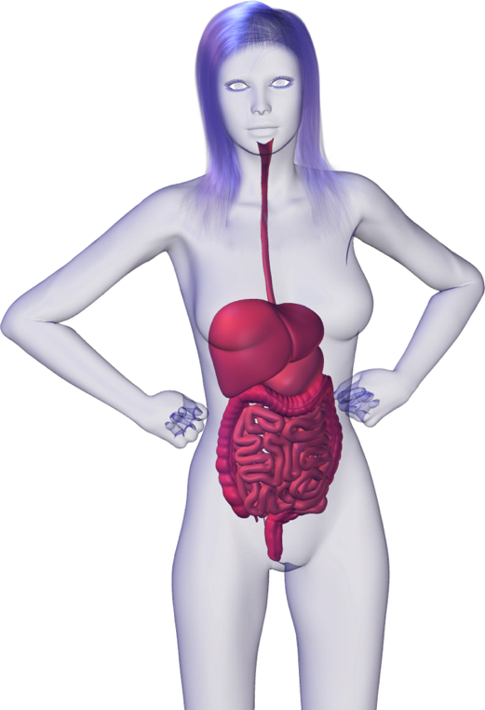
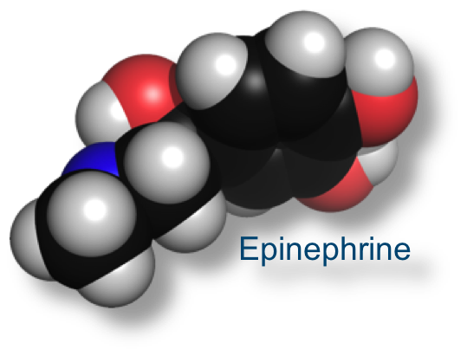
Digestive System
The endocrine system interacts with the digestive system
  The digestive system provides nutrients to all endocrine organs.
  Hormones produced in the gastrointestinal (GI) system influence GI function.
  Catecholamines (e.g. epinephrine) influence the activity of the digestive system.

Slide 9
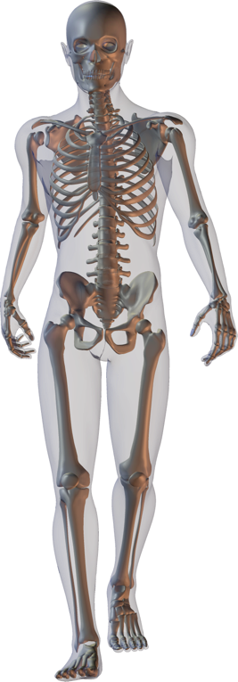
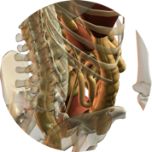
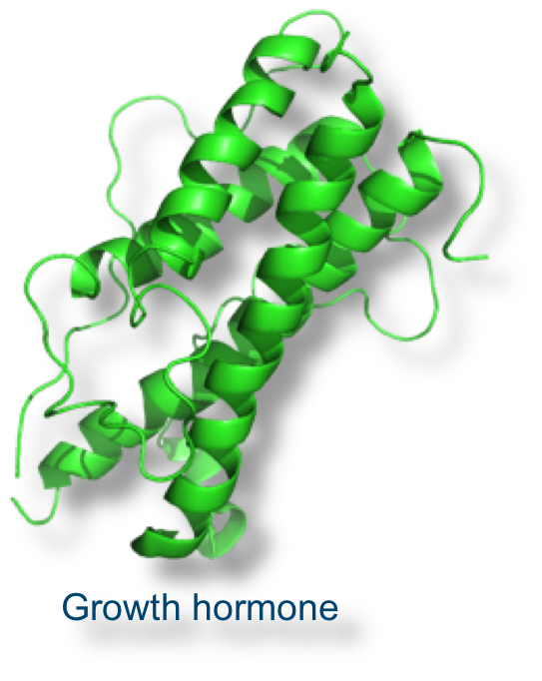
Skeletal System
The endocrine system interacts with the skeletal system
  The skeleton protects the endocrine glands.
  Parathyroid hormone regulates blood calcium.
  Growth hormone, and thyroid and sex hormones regulate skeletal growth and development.

Slide 10
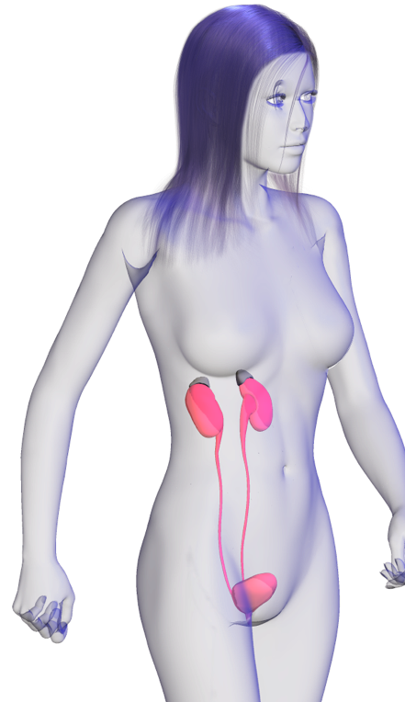
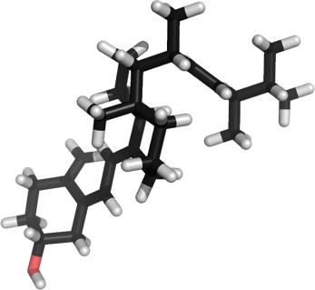



Urinary System
The endocrine system interacts with the urinary system
  Final activation of vitamin D occurs in the kidneys (bioactive vitamin D is classed as a steroid hormone).
  Erythropoietin is a glycoprotein hormone released by kidneys promotes red blood cell formation (erythropoiesis).
Vitamin D
Red blood cells

Slide 11
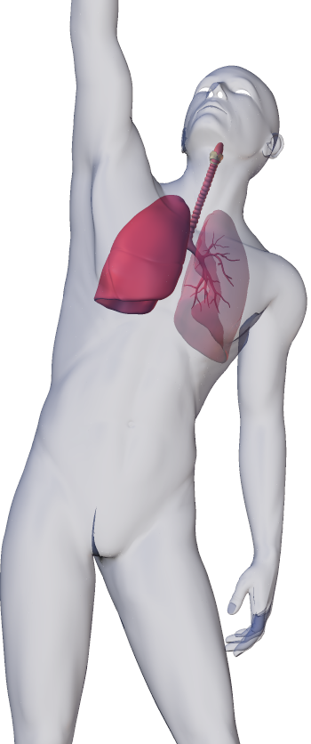
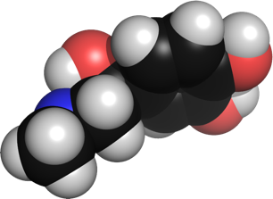
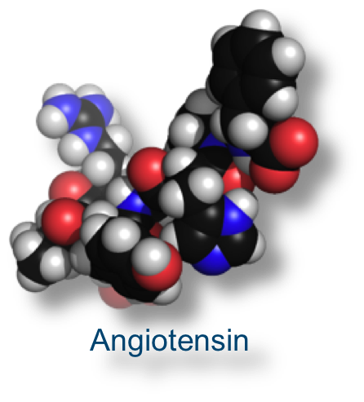
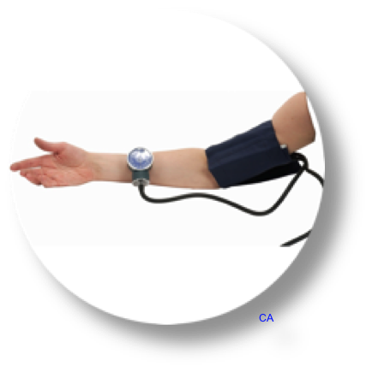
Respiratory System
The endocrine system interacts with the respiratory system
  Epinephrine (adrenaline) dilates the bronchioles and increases the rate and depth of breathing.
  Angiotensin I is converted to angiotensin II in the lung capillaries. Angiotensin II increases vasoconstriction, although its effect is insignificant in the lung tissue itself.
Adrenaline

Slide 12
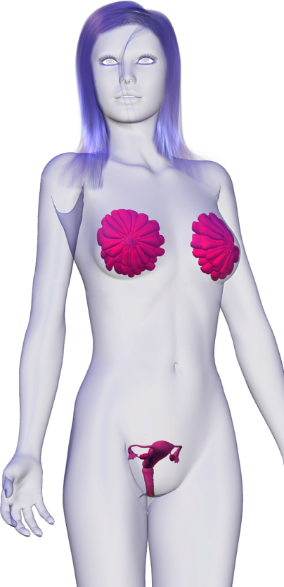
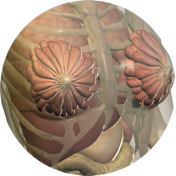
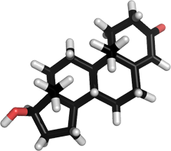
Reproductive System
The endocrine system interacts with the reproductive system
  Hormones influence the development of breast tissue during pregnancy and breast-feeding.
  Hormones from the hypothalamus, gonads, and pituitary regulate the development and functioning of the reproductive system.
  Testosterone underlies sexual drive.
Mammary glands
Testosterone

Slide 13
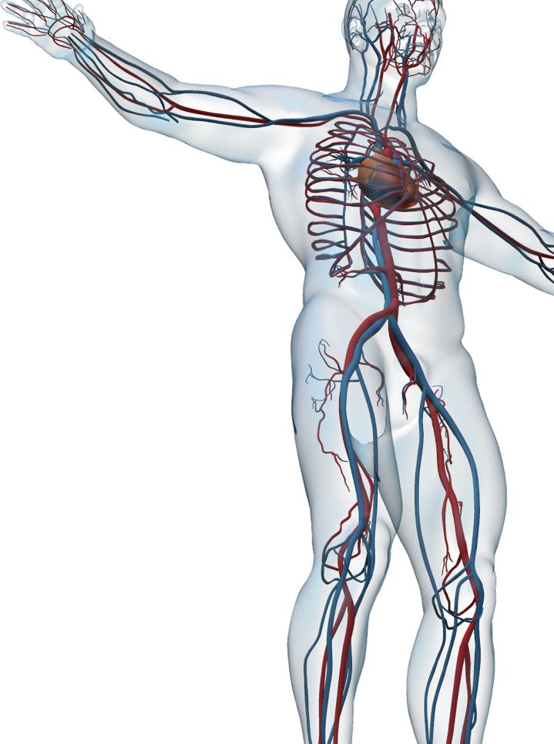
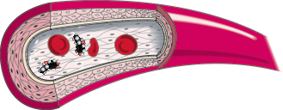

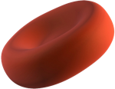
Cardiovascular System
The endocrine system interacts with the cardiovascular system
  Hormones influence blood pressure and volume, and heart activity.
  Hormones are transported in the blood.
  The hormone erythropoiten (EPO) stimulates red blood cell production.
Red blood cells

Slide 14
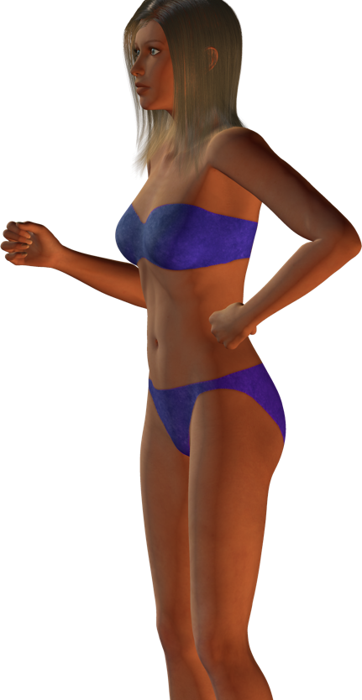
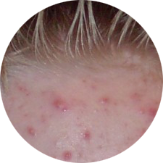
Integumentary System
The endocrine system interacts with the integumentary system.
  Sebaceous glands are influenced by sex hormones.
  The skin synthesizes the precursor to bioactive vitamin D, which is required for absorption of calcium from the gut.
Acne
Vitamin D

Slide 15
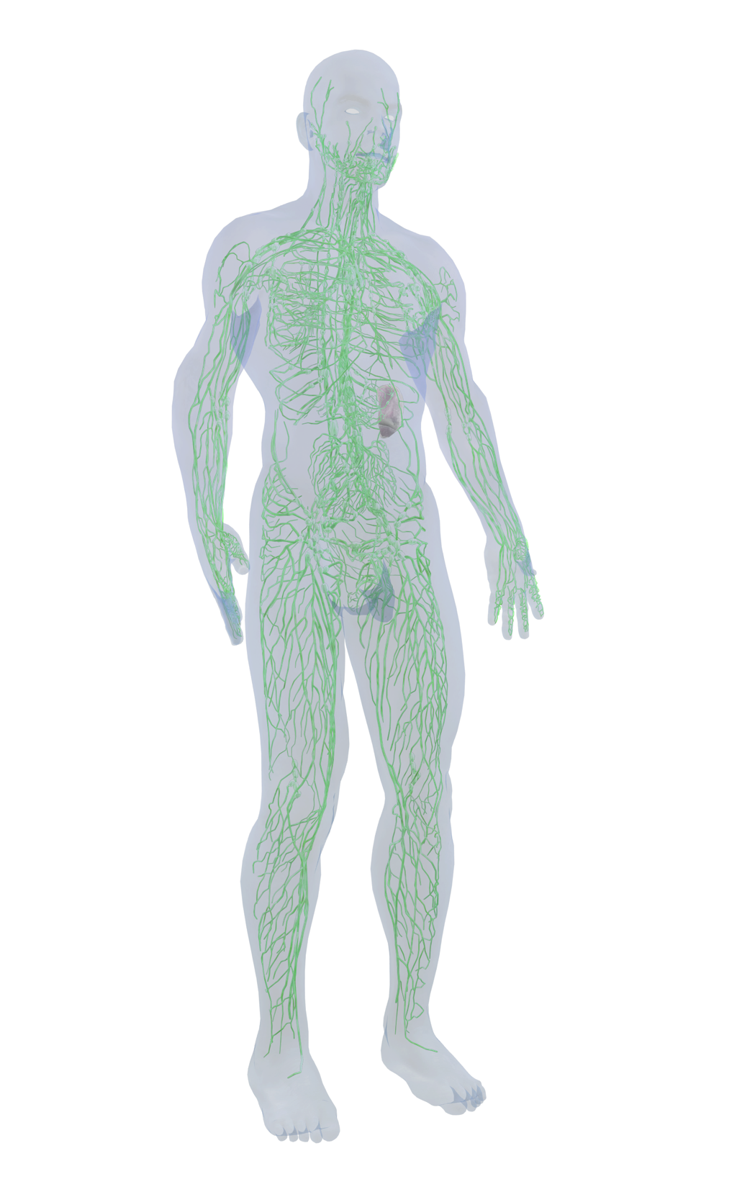
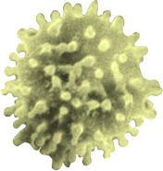
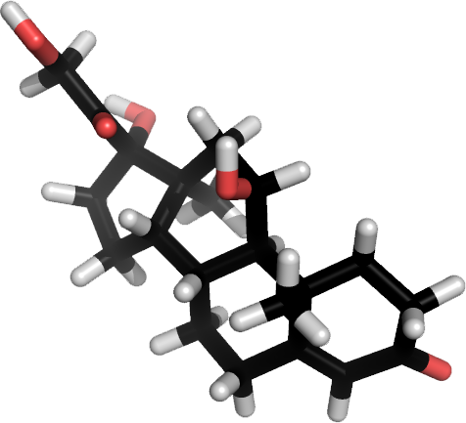
Lymphatic System
The endocrine system interacts
with the lymphatic and immune systems
  Lymphocytes mature in the thymus.
  Hormones can be transported by the lymph.
  Glucocorticoids (e.g. cortisol) depress the immune response.
Lymphocyte
Cortisol

Slide 16
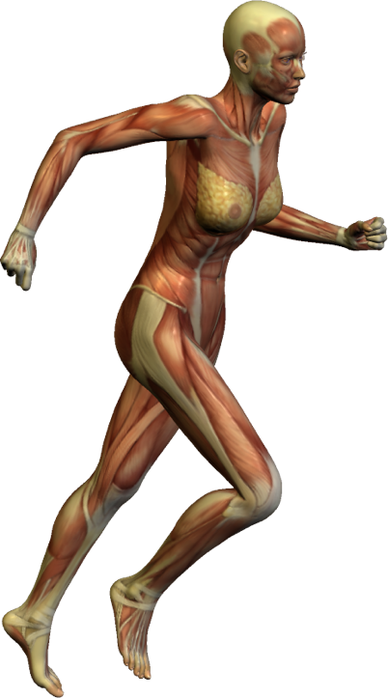

Muscular System
Growth hormone
The endocrine system interacts with the muscular system
  Growth hormone is required for normal muscle development.
  Muscular activity promotes the release of catecholamine hormones from the adrenal medulla.
  Thyroid hormones and catecholamines influence muscle metabolism.
Adrenaline

Slide 17
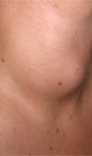

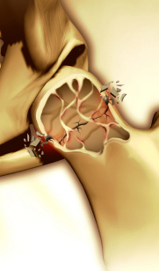
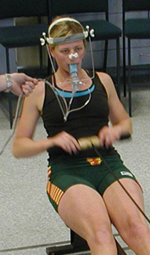
Contexts
Disease
What are the
diseases of the
endocrine system
and what are
their symptoms?
Medicine and Technology
How do we
prevent, diagnose,
and treat disease
of the endocrine
system?
Integration and Control
The Endocrine System
The endocrine system is closely linked to the nervous system Diseases or disorders of the endocrine system can have severe effect on the body.
Medical technologies can be used to diagnose disorders of the endocrine system. The endocrine system is affected by exercise and aging.
Drahreg01CC 3.0
The Effects of Aging
How does
aging affect
the endocrine
system.
The Effects of Exercise
What are the
effects of
exercise on the
endocrine
system?
Photo: Wintec academy of sport
iStock

Slide 18
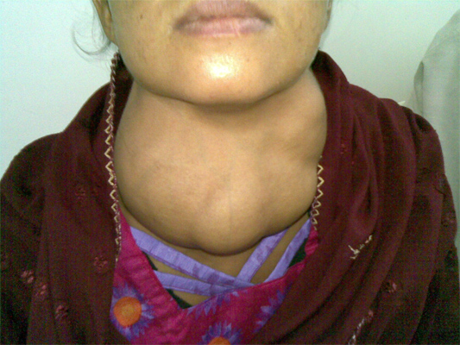
Disease
Hormones often have widespread effects, so diseases or disorders of the endocrine system can cause extensive problems and a wide range of symptoms.
Diseases or disorders may result from damage to an endocrine organ (e.g. by trauma, infection, or lack or nutrient), from autoimmune diseases which affect endocrine function, or from congenital abnormalities e.g. pituitary dwarfism.
Goiter

Slide 19
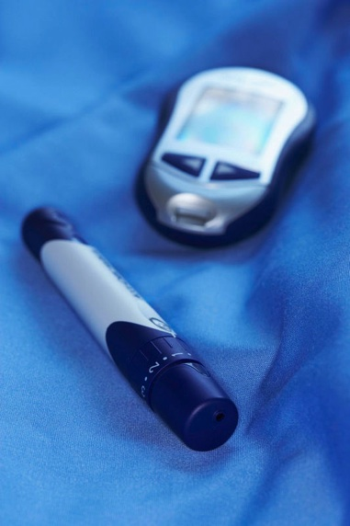
Medicine and Technology
Advances in medical technology and microcircuits have allowed quicker and more accurate diagnosis of endocrine disorders (e.g. measuring blood sugar levels in diabetics).
Inefficient or faulty hormone production can be treated by drug therapies. For example diabetes insipidus is treated with injections of synthetic ADH.
CA

Slide 20

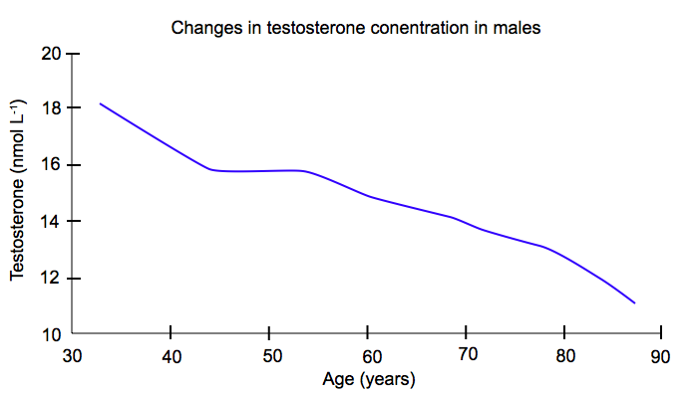
Effects of Age
Age related changes in the secretion and response to hormones are related to natural degenerative changes in endocrine function resulting in changes in body shape, growth, and behavior.
For example aldosterone, which helps to regulate fluid and electrolyte balance, is around 30% lower in people over 70 than in younger adults.
In males, testosterone levels slowly decrease from about 30 years of age onwards.
  Blood levels of some hormones decrease, others increase, and some remain unchanged, but their target tissue is less responsive.
CA
Hormonal changes during aging account for many of the changes in body shape and behavior.

Slide 21
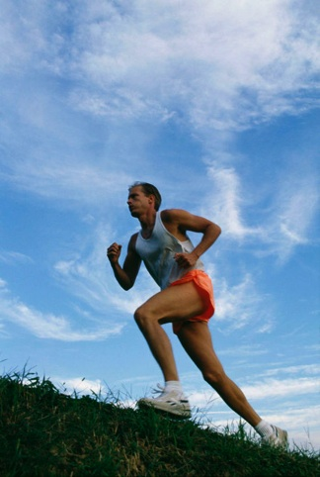
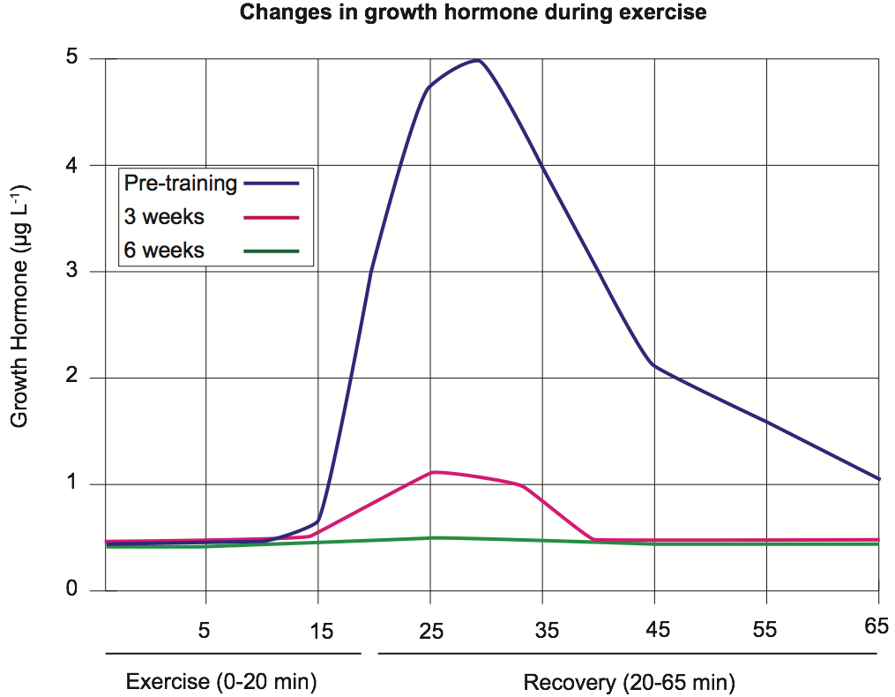
Exercise
A number of hormonal changes occur in the body during exercise.
In general, people who exercise regularly have lower hormone secretions during exercise than people who do not (below).
  This is likely to represent a greater efficiency in response to hormones in people who regularly exercise.
Med Sci Sports Exercise 1997

Slide 22
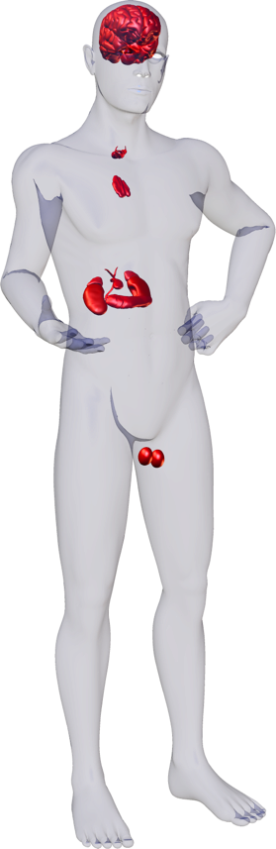
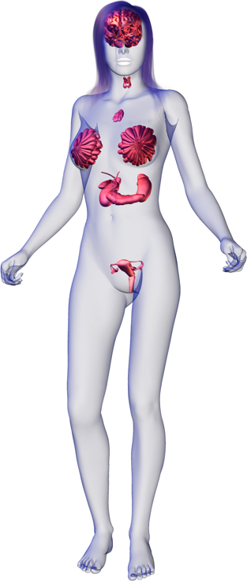
Endocrine Glands
2
6
7
5
1
Adrenal glands
10
2
Hypothalamus
9
1
3
Ovaries (female)
4
Pancreatic islets
4
5
Parathyroid glands
3
6
Pineal
8
7
Pituitary gland
8
Testes (male)
9
Thymus gland
10
Thyroid gland

Slide 23
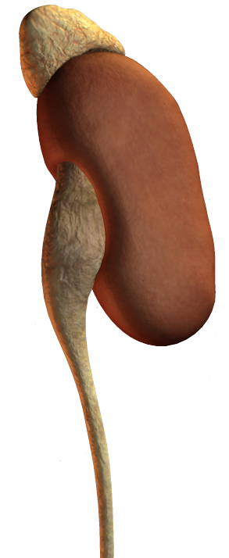
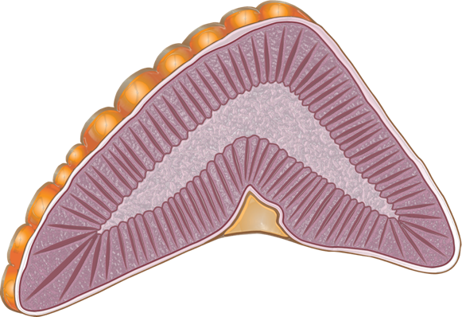
Adrenal Glands
Adrenal gland
The adrenals (also known as the suprarenal glands) are located on the superior surface of the kidneys.
The adrenal medulla produces epinephrine(adrenaline) and norepinephrine (noradrenaline), involved in the fight of flight response.
The adrenal cortex produces various steroid hormones including:
  cortisol (response to stress)
  aldosterone (sodium regulation)
Medulla
Kidney
Cortex

Slide 24
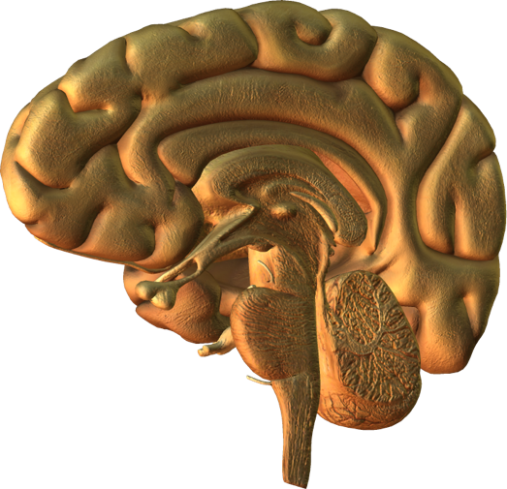
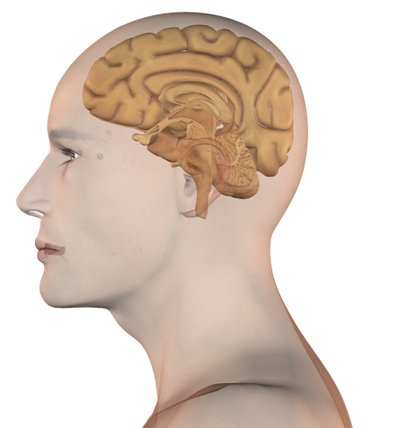

Hypothalamus
The hypothalamus coordinates nervous and endocrine systems.
It secretes releasing hormones, which regulate the hormones of the anterior pituitary.
It also produces the neurohormones oxytocin and ADH, which are transported to and released from the posterior pituitary.
hypothalamus

Slide 25
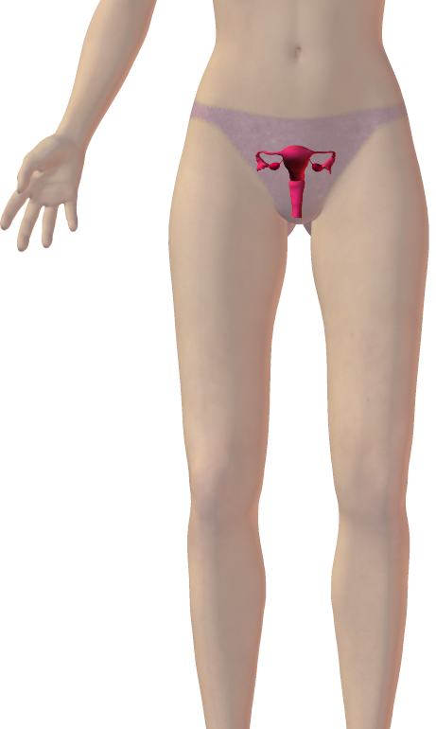
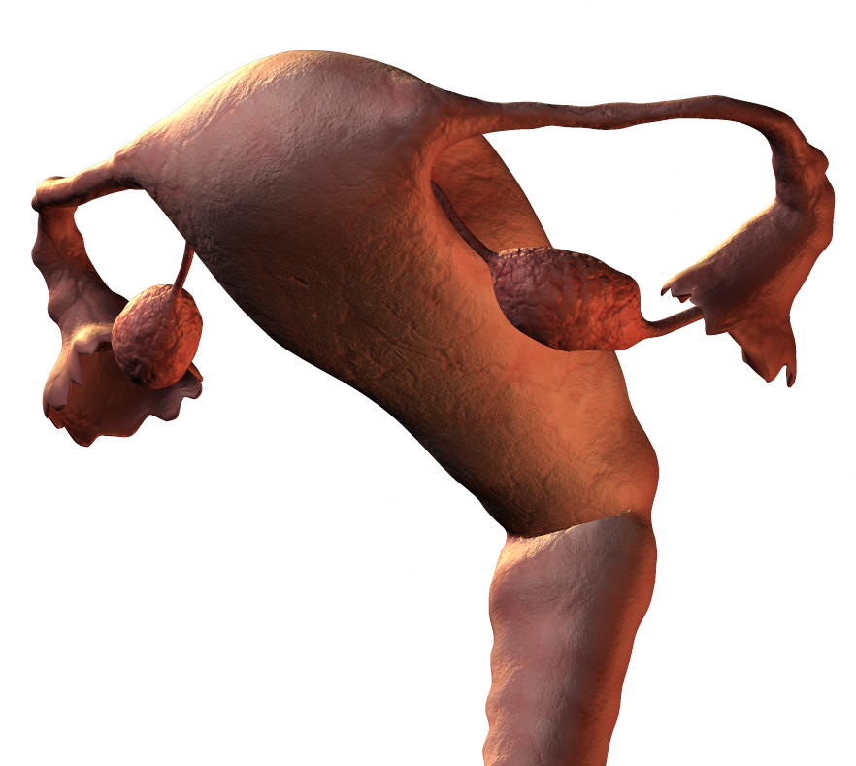
Ovaries (Females)
The ovaries are both endocrine glands and gonads, located in the lateral wall of the pelvis on either side of the uterus.
The ovaries produce estrogen and progesterone.
These hormones control and maintain:
  female characteristics
  stimulate menstrual cycle
  maintain pregnancy
  prepare the mammary glands for lactation
Ovaries

Slide 26



Pancreatic Islets
The endocrine portion of the pancreas is called the islets of Langerhans. The islets are scattered throughout the pancreatic tissue.
  Each islet is about 0.2 mm in diameter.
Specialized α cells and β cells in the islets of Langerhans produce insulin and glucagon respectively.
Together, these control blood sugar levels.
Insulin (green)
Glucagon (red)
Solimena Lab, Med. Fac., University of Technology, Dresden, Germany CC 3.0
Cell nuclei (blue)
Pancreas
Islet of Langerhans

Slide 27


Parathyroids
These are located on the posterior surface of the thyroid gland.
Parathyroid glands secrete PTH (parathyroid hormone) which regulates blood calcium levels and promotes release of calcium from bone.
High levels of calcium in the blood inhibit PTH secretion.
Parathyroid glands
(on posterior of thyroid)
Trachea

Slide 28



Pineal Gland
This small gland in the brain secretes melatonin, which regulates the sleep-wake cycle.
Melatonin secretion follows a circadian rhythm and coordinates reproductive hormones too.
Pineal gland

Slide 29

Pituitary Gland
The pituitary is located below the hypothalamus.
It secretes at least nine hormones that regulate the activities of other endocrine glands.
Secretions of the anterior pituitary are regulated by releasing hormones from the hypothalamus.
Anterior pituitary
Posterior pituitary

Slide 30


Testes (Males)
Like the female ovaries, the testes are both endocrine organs and gonads.
  The testes are supported below the torso in an extension of the abdomen called the scrotum.
The testes produces testosterone, which:
  Controls and maintains: “maleness”
  (muscular development and deeper voice)
  Promotes sperm production
Testis functions are regulated by gonadotropic hormones produced by the anterior pituitary.
Testes

Slide 31


Thymus Gland
The thymus is a rather diffuse organ located in front of the heart and behind the sternum.
The thymus is large in infants, but decreases in size during adulthood.
The thymus produces thymosin that is essential for the development of T-lymphocytes and the immune system.
Thymus

Slide 32

Thyroid Gland
The thyroid is a shield-shaped gland found in the neck below the thyroid cartilage, which forms the Adam’s apple.
The thyroid gland secretes thyroxine, and iodine containing hormone needed for normal growth and development.
Thyroxine stimulates metabolism and growth via protein synthesis.
Thyroid secretion is regulated by thyrid-stimulating hormone (TSH) from the anterior pituitary. TSH release is itself regulate by a hypothalamic releasing hormone.
Thyroid gland
Trachea

Slide 33


Diagnosis of Disorders
There is a wide range of techniques available to medical practitioners today to diagnose endocrine disorders.
  Genetic testing and screening
    Genetic screening and testing can help diagnose disorders or help prospective parents make more informed decisions.
  Medical imaging techniques
    Imaging techniques including ultrasound and MRI can be used to diagnose tumors in endocrine organs.
  Blood tests
    Tests, such as blood-glucose levels, and tests for thyroid function can help diagnose problems in the endocrine system.

Slide 34


Treatment of Disorders
A number of options are available for the treatment of endocrine disorders.
  Drug therapies
    Hormone replacement therapies (e.g. growth hormone) or the use of inhibitors can treat some endocrine disorders.
  Dietary management
    Managing diet (such as management of sugar intake or iodine supplementation) can help overcome endocrine disorders.
  Radiotherapy
    Treatment of cancers may require radiotherapy.
  Stem cell therapy and transplants
    Inserting new cells able to produce the required hormones is an area of ongoing research (e.g. transplant of pancreatic endocrine tissue has been successful in diabetics).

Slide 35




Endocrine Signaling
The endocrine system regulates the body’s processes by releasing chemical messengers called hormones into the bloodstream.
Hormones are produced in minute quantities yet can have a large effect on metabolism.
Endocrine organs may be stimulated by a hormonal, humoral or neural stimulus.
Hormonal stimuli
One hormone-producing gland induces another to produce its own hormones.
Humoral stimuli
Changes in levels of ions and nutrients in the blood stimulate the production of hormones by an endocrine gland.
Neural stimuli
Nerve fibers may stimulate hormone release.

Slide 36




Hormones
Hormones are carried in the blood to exert a specific metabolic effect on target cells.
After exerting their effect, hormones are broken down and excreted.
Hormones can be amino acids, peptides, proteins, fatty acids, or steroids.
Thyroxine (amino acid)
Testosterone (steroid)
Prostaglandin (fatty acid)
Human growth hormone (protein)
Thyrotropin releasing hormone (peptide hormone)

Slide 37

Hormone Action
Endocrine cells produce hormones and secrete them into the blood where they are distributed throughout the body.
  Despite their wide distribution, hormones only affect specific target cells.
Hormone travels in the bloodstream
throughout the body
Target cells
Endocrine cell secretes hormone into bloodstream
Blood vessel
Cytoplasm
Plasma membrane
The stimulus for hormone production and release can be:
– another hormone (hormonal)
– a blood component (humoral)
– neural (a nerve impulse)
Receptors on the target cell receive the hormone
Hormone receptor
Hormone molecule

Slide 38


Antagonistic Hormones
The effects of one hormone are often counteracted by an opposing hormone.
Feedback mechanisms adjust the balance of the two hormones to maintain physiological function.
  Example: insulin decreases blood glucose and glucagon raises it.
Raises blood glucose level
Increase in blood glucose stimulates insulin release
Decrease in blood glucose stimulates glucagon release
Glucagon secretion
Insulin secretion
Lowers blood glucose level

Slide 39

Cell Communication and Recognition
Cells have means of communication
and recognition which allow them to:
  form tissues with cells of the same or
  a related type.
  detect foreign cells and launch an
  immune response.
Special signaling proteins in the
plasma membrane act as:
  receptor molecules for hormones
  and neurotransmitters
  identity markers
Signaling proteins are often glycoproteins.
Connexins are protein channels that connect neighboring cells and allow direct cell-to-cell communication

Slide 40


Cell Signaling
Cells use signaling molecules (chemical messengers) to:
  gather information about the environment
  respond to changes in their environment
  communicate with other cells
The signaling and response process is called the signal transduction pathway.
  It often involves a number of enzymes and their substrates in a signal cascade that results in a large response in the target cell.
CA
The caffeine contained in this cup of coffee acts as a chemical signal, stimulating the central nervous system. It will temporarily reduce physical fatigue and increase mental alertness in the user.
Caffeine is a metabolic stimulant. It is represented here as a 3D stick model.

Slide 41


Types of Cell Signaling
There are three main pathways by which cell signaling occurs:
  the endocrine pathway
  the paracrine pathway
  the autocrine pathway
Some signal molecules act in several ways.
  For example testosterone from the testes acts as an endocrine signal to stimulate muscle growth and a paracrine signal to stimulate spermatogenesis.
Testosterone stimulates muscle development by endocrine signaling (above).
Testosterone stimulates spermatogenesis by paracrine signaling

Slide 42

Endocrine Signaling
Cell signaling pathways are categorized primarily on the distance over which the signal molecule is transmitted.
In the endocrine pathway, the signals are hormones, released by endocrine glands. They travel via the circulatory system to target cells and tissues.
Blood vessel
Hormone
Target cell
Endocrine signaling involved hormones carried in the blood, e.g. sex hormones, growth factors and neurohormones such as dopamine.

Slide 43

Autocrine Signaling
The autocrine pathway involves a cell producing, and reacting to, its own signal. This pathway is seen in the T-cell response to infection .
Signal molecule
In vertebrates, T-cells produce a growth factor when they encounter a foreign antibody. They respond to the growth factor by proliferating.

Slide 44


Paracrine Signaling
In the paracrine pathway, a signal released from a cell acts on target cells within its immediate vicinity.
  The production and transmission of neurotransmitters, which are used to transfer signals between a cell and a neuron, is an example of a common paracrine signaling pathway.
Direct cell to cell signaling is a form of paracrine signaling:
  The chemical message is transferred directly between neighboring cells. This form of signal transduction is important during embryonic development.
Signal molecule
In paracrine signaling, a signal released from a cell and acts upon target cells within its immediate vicinity.
Signal molecule
Direct cell to cell signaling involves a signal molecule being transferred directly between neighboring cells.

Slide 45



Types of Cell Signaling Molecules
Cell signals (ligands) are a varied group of chemical messengers. They fall into six broad groups:
  Steroid hormones (e.g. progesterone).
  Simple gases (e.g. nitric oxide).
  Neurotransmitters (e.g. adrenalin).
  Peptide hormones and growth factors (e.g. insulin).
  Fatty acid derivatives, (e.g. prostaglandins).

Slide 46

Types of Signal Receptors
The binding sites of cell receptors are very specific; they will only bind certain signal molecules (ligands).
This prevents them from reacting to every signal encountered by the cell.
Cell receptors fall into two major categories:
  Transmembrane receptors: these span the plasma membrane and bind the ligands that cannot cross the membrane, and include:
    ion channels.
    protein kinases.
    G-protein linked receptors.
  Cytoplasmic receptors: these are located within the cell cytoplasm. They bind the ligands that can cross the plasma membrane.
Extracellular domain
Outside of cell
Intracellular domain
Cell cytosol
Transmembrane receptors (above) have an extracellular domain located outside the cell, and an intracellular domain within the cell cytosol.

Slide 47




Gated Ion Channels
Ligand
Outside of cell
1
Ligands can open channels for second messengers.
Ions such as Ca²⁺ can be used as second messengers in signaling.
  Ions enter the cell via an ion channel.
  A ligand binds to a receptor on the ion channel protein(s), causing a conformational change that opens the channel for ion entry.
  Ion channels my be ligand-gated or voltage-gated.
Calcium is involved in the release of neurotransmitters at synapses.
Ion channel
Cell cytosol
Ligand
Outside of cell
2
Ion channel
Cell cytosol

Slide 48




Second Messenger
Peptide hormone in bloodstream (first messenger)
Hormone binds to receptor activating adenylate cyclase
Membrane receptor
Peptide hormones operate by interacting with transmembrane receptors and activating a second messenger system e.g. cyclic AMP (cAMP).
Cellular concentration of cAMP increases markedly once a hormone binds and the cascade of enzyme driven reactions is initiated.
ATP
cAMP is synthesized from ATP The process requires the enzyme adenylate cyclase
cAMP
cAMP activates protein kinase A, beginning a signal cascade which brings about a cellular response.
Epinephrine is a hormone that operates through cAMP as a second messenger.
Alteration of cell function

Slide 49



Gene Activation by Steroids
Steroid hormones enter the cell to interact directly with intracellular cytoplasmic receptors.
Once inside the target cell, steroids bind to intracellular receptor sites, creating hormone-receptor complexes that activate specific genes.
Steroid hormone in bloodstream
lipid-soluble steroid hormone diffuses easily through the plasma membrane.
Activation of genes on DNA
Alteration of cell function
Cortisol is a steroid that effects its actions by activating genes

Slide 50

Hypothalamus
The hypothalamus is located below the thalamus, just above the brainstem and pituitary gland.
It receives information from sensory receptors and uses this information to to control and integrate many basic physiological activities, including:
  temperature regulation
  food and fluid intake
  sleep
Hypothalamus

Slide 51

Role of the Hypothalamus
Neurosecretory cells
One of the most important functions of the hypothalamus is to link the endocrine system to the nervous system via the pituitary.
The hypothalamus contains neurosecretory cells.
  These are specialized secretory neurons, which are both nerve and endocrine cells.
Hypothalamus
Anterior pituitary
(adenhypophysis)
Posterior pituitary(neurohypophysis)
Structure of hypothalamus and pituitary

Slide 52

Hypothalamus Structure
Neurosecretory cells in the hypothalamus secrete neurohormones into capillaries. These releasing hormones control the release of hormones from the anterior pituitary.
Neurohormones from the hypothalamic neurosecretory cells supplying the posterior pituitary.
Artery
Portal vein links two capillary networks
Neurosecretory axons
Anterior pituitary is truly glandular and secretes hormones in response to the hypothalamic hormones.
Posterior pituitary is neural in origin
Releases at least seven peptide hormones, including GH, TSH, and ACTH
Stores and releases oxytocin and ADH produced by the hypothalamus.

Slide 53

Neurosecretory Cells
Neurosecretory cells produce hormones (usually peptides) in the cell body.
These are packaged into droplets and transported along the axon.
At the axon terminal the neurohormone is released into the blood in response to nerve impulses.
Neurons from the central nervous system
Cell body
Nerve impulse
Axon
Neurosecretory vesicles
Mitochondrion
Membrane receptor
Capillary

Slide 54


The Stress Response
The interactions of the hypothalamus, pituitary, and adrenal glands constitute the hypothalamic-pituitary-adrenal axis.
  It is responsible for controlling the body’s reaction to stress and regulating many other functions.
The stress response may be influenced by nervous impulses and hormones.
The short term stress response is triggered by sympathetic stimulation of the central medulla region of the adrenal glands.
  The stimulation causes the release of catecholamines (epinephrine and norepinephrine) which prepare the body for short term stress.
Continued stress results in the release of glucocorticoids (e.g. cortisol). These hormone help the body to resist long term stress.
CA
The response to fright is generally short term and immediate (fight or flight).
CA
Long term stress can lead to exhaustion.

Slide 55

Response to Stress
Short Term Response
Long Term Response
Hypothalamus
Spinal cord
Synapse
Nerve impulses
Blood vessel
Adrenal medulla
Sympathetic nerve fibers
Adrenal medulla
Adrenocorticotropic hormone
Catechloamines e.g. epinephrine(adrenaline)
Glucocorticoids e.g. cortisol

Slide 56


Short Term Response
Generally known as the fight or flight syndrome.
The physiological changes occurring as part of the short term stress response help us to operate at peak efficiency when endangered, competing, or whenever a high level performance is required.
Changes include:
  Increased heart rate
  Increased blood pressure
  Liver converts glycogen to glucose to increase blood glucose levels
  Blood flow to the gut and kidney is reduced
  Blood flow to the brain is increased
  Increased metabolic rate
CA
CA
Epinephrine (adrenaline) may be released by the adrenal glands in response to nervous tension (start of race top) or fear (above).

Slide 57

Long Term Response
A state of long term unrelieved stress is not normal.
  The body responds to prolonged periods of stress by making physiological changes to resist the stress. (e.g. conserving energy during starvation).
  If the stress continues unrelieved, the body enters a phase of exhaustion, where its resistance to stress is eroded, and the immune system fails and loses its ability to fight disease.
Physiological changes include:
  Proteins and fats converted to glucose or broken down for energy
  Increased blood sugar
  Suppression of the immune system
CA

Slide 58

Hormones of the Pituitary
The pituitary gland is an endocrine gland about the size of a pea hanging from the inferior surface of the hypothalamus.
It pituitary comprises two distinct regions:
  Anterior pituitary: glandular in origin
  Posterior pituitary: neural in origin (an extension of the hypothalamus)
Anterior pituitary
Posterior pituitary

Slide 59

Anterior Pituitary
The anterior pituitary releases at least seven peptide hormones into the blood.
  The release of these hormones is regulated by releasing and inhibiting hormones from the hypothalamus.
Thyroid Stimulating Hormone
Increases synthesis and secretion of thyroid hormones T3 and thyroxine) from the thyroid gland.
Growth Hormone
Stimulates protein synthesis and growth in most tissues. One of the main regulators of metabolism.
Adrenocorticotrophic Hormone
Usually abbreviated to ACTH, this hormone increases synthesis and secretion of hormones (aldosterone and cortisol) from the adrenal cortex.
Prolactin
Stimulates growth of the mammary glands and synthesis of milk protein.
Follicle Stimulating Hormone
In females: Stimulates maturation of the ovarian follicles.
In males: Increase the production of sperm in the seminiferous tubules
Luteinizing Hormone
In females: Stimulates secretion
of ovarian hormones, ovulation, and formation of the corpus luteum.
In males: (ICSH) Stimulates synthesis and secretion of testosterone.
Melanophore Stimulating Hormone
Increases melanin synthesis and dispersal in the skin’s melanocytes.

Slide 60
Posterior Pituitary
The posterior pituitary develops as an extension of the hypothalamus.
  The release of its two hormones oxytocin and antidiuretic hormone occurs directly as a result of nervous input to the hypothalamus.
Oxytocin
Acts on the mammary glands to stimulate milk ejection (let down).
Antidiuretic Hormone (ADH)
Acts on the collecting duct of the kidney to increase water reabsorption from the filtrate (urine).
Oxytocin
Acts on the uterus to stimulate smooth muscle contraction during labor.

Slide 61

Effects of Growth Hormone
Growth hormone (GH) is released in response to growth hormone releasing hormone (GHRH) from the hypothalamus.
  GH acts both directly and indirectly to affect metabolic activities associated with growth.
GH directly stimulates metabolism of fat, but its major role is to stimulate the liver and other tissues to secrete insulin like growth factor (IGF-1).
  IGF-1 stimulates bone and muscle growth.
CA

Slide 62

Effects of Growth Hormone
Growth hormone secretion is regulated by negative feedback
  High levels of IGF-1 suppress GHRH secretion from the hypothalamus.
  High levels of IGF-1 also stimulate release of somatostatin (also known as growth hormone inhibiting hormone) from the hypothalamus, which also suppresses GH secretion.
    Somatostatin is also secreted rom parts of the digestive tract.
GHRH
-
Bone
+
Stimulates the proliferation of chondrocytes and bone growth
Anterior pituitary
+
Fat
GF
+
Directly stimulates the utilization of fat
Stimulates muscle growth through protein synthesis and proliferation
of myoblasts
IGF-1
IGF-1
+
Liver
Muscle

Slide 63

Control of Blood Glucose
The endocrine portion of the pancreas (the α and β cells of the islets of Langerhans) produces the hormones insulin and glucagon.
  These hormones act antagonistically to maintain blood glucose at a steady state through negative feedback.
Regulation of blood glucose to within narrow limits allows energy to be available to cells as needed.
Glucagon promotes an increase in blood glucose by stimulating the breakdown of glycogen and the synthesis of glucose from amino acids.
Insulin promotes a decrease in blood glucose by promoting cellular uptake of glucose glycogen synthesis in the liver.

Slide 64

Blood Glucose vs Insulin
The graph below shows the changes in blood glucose and insulin levels over a 24 hour period, during which three meals are eaten.

Slide 65
Blood Glucose Regulation
The body’s extra energy is stored as glycogen or fat, and mobilized to meet energy needs as required.
The liver is pivotal in these carbohydrate conversions.
  One of the consequences of a disruption to this system is the disease diabetes mellitus.
Beta cells
Alpha cells
Stimulates β cells to secrete insulin
Stimulates α cells to secrete glucagon
Insulin promotes uptake of glucose by cells and conversion of glucose to stored glycogen or fat in the liver.
Glucagon stimulates breakdown of glycogen to glucose in the liver.
Normal blood glucose (BG) level
3.9 - 5.6 mmol L⁻¹
Uptake of glucose from blood
Release of glucose into the blood

Slide 66
Insulin Signaling Pathway
Insulin is a peptide hormone secreted by the pancreas. Its primary role is maintaining blood glucose homeostasis.
Insulin production is tightly regulated because over-or underproduction has serious physiological consequences (even death):
  too little insulin results in elevated blood glucose levels (hyperglycemia).
  too much insulinresults in low blood glucose levels (hypoglycemia).
The insulin receptors (right) are surface-bound protein kinase receptors. They facilitate a cellular response by catalyzing the transfer of a phosphate group from ATP to a target protein.
  Insulin receptors are made up of four subunits: 2 α-subunits and 2 β-subunits.
Outside of cell
α-subunits
β-subunits
Extracellular domain
Intracellular domain
Cell cytosol

Slide 67
Insulin Signaling Pathway
Two molecules of insulin must bind to the extracellular domain of the insulin receptor to activate it.
Once the insulin is bound, phosphate groups are added to the receptor in a process called autophosphorylation.
Unbound insulin
Bound insulin
Phosphate groups
Inactive insulin receptor (no insulin bound)
Active insulin receptor (insulin bound)

Slide 68
Insulin Signaling Pathway
The autophosphorylation of the receptor begins a signal cascade, in which several other proteins are phosphorylated in sequence.
This culminates in the movement of Glut4 storage vesicles to the plasma membrane and the embedding of the Glut4 glucose transporter protein into the plasma membrane.
  These allow the uptake of glucose from the extracellular environment.
Glucose
Glut4 glucose transporter
Inactive molecule
Active molecule
Glut4 SV

Slide 69

Symptoms of Disease
Symptoms of endocrine disorders include:
  Loss of function or control.
    The inability of the endocrine system to produce or respond to the correct hormonal signals can result in the loss of the body’s ability to regulate key aspects of metabolism (e.g. the loss of insulin production leads to an inability to control blood glucose levels).
  Developmental failure.
    Hormones can have large scale effects of the body. Examples include the over or under production of human growth hormone by the pituitary, resulting in excessive or insufficient growth of the body.
Insulin injection for type I diabetes
Istock
Growth hormone

Slide 70

Diseases of the Endocrine System
Diseases of the endocrine system include:
  Genetic diseases (e.g. type 1 diabetes)
    Mutations in genes can lead to the faulty production of a hormone or its intermediate.
  Cancers (e.g testicular cancer, right)
  Autoimmune damage
    Malfunction of the immune system can cause immune attacks of the endocrine glands, damaging them and resulting in disrupted hormone production (e.g. type 1 diabetes).
  Dietary related diseases
    Poor dietary choices in childhood can lead to adult onset diabetes (type 2 diabetes)
Cancer
Photo: Ed Uthman

Slide 71
Type 1 Diabetes Mellitus
Type I diabetes (also called insulin dependent diabetes mellitus) is the least common form of diabetes mellitus (about 10% of cases) and the most severe. About 1 in 1000 children develop type 1 diabetes by the age of 16.
  It is a disease resulting from insufficient or no insulin production, usually due to the autoimmune destruction of the beta cells of the pancreatic islets.
  The onset is sudden, often between the ages of 10 and 16 (hence its olden name, juvenile-onset diabetes).
  There is a genetic component but a triggering factor, such as a viral infection, causes the disease to develop.
  It is fatal unless treated with insulin.
Concentration of blood glucose after fasting blood glucose test
Condition | mg dL⁻¹
Normal | <99
Possible pre-diabetes | 99 - 126
Diabetes mellitus | >126
The simplest way to diagnosis diabetes by the fasting blood glucose test. After not eating for around 12 hours the concentration of glucose in the blood is measured. A positive result is a concentration above 126 mgdL⁻¹

Slide 72


Type 1 Diabetes Mellitus
Endocrine region of a normal pancreas enlarged to show function of cell types
Pancreas
Alpha cells produce glucagon which promotes glucose release from the liver
Delta cells produce somatostatin which inhibits the release of growth hormone from the anterior pituitary
Beta cells produce insulin, the hormone responsible for cellular uptake of glucose. It is these cells that are destroyed in type 1 diabetes mellitus.

Slide 73




Symptoms of Type 1 Diabetes
3
Constant thirst to compensate for excessive urine production. (polydipsia). Increased hunger (polyphagia) and weight loss.
1
Without insulin, the body’s cells cannot take up glucose and lack an energy source for their metabolism.
4
Muscles: Inability to utilize glucose leads to weakness and fatigue.
2
Kidneys: volume of urine increases to clear the body of excess blood glucose (polyuria).
5
Fats are metabolized for energy leading to a fall in blood pH (ketosis). This is potentially fatal.
6
Bladder and urinogenital tract: High sugar levels in the blood and urine promote bacterial and fungal infections.
CA

Slide 74


Treating Type 1
Diabetes
Present treatments for type 1 diabetes include:
  Regular insulin injections combined with dietary management to keep blood sugar levels stable.
    Blood glucose is monitored regularly with testing kits to guard against sudden falls in blood glucose (hypoglycemia).
  Insulin was once extracted from dead animals.
    Now, genetically engineered yeast or bacterial cells containing the gene for human insulin are grown in culture, providing abundant, low cost insulin, without the side effects associated with animal insulin.
Istock

Slide 75


New and Future Treatments
Cell therapy in a relatively new alternative to insulin injections.
  Cell therapy involves the transplant of insulin-producing β- islet cells. To date, approximately 500 patients worldwide have received islet cell transplants from donor pancreases, with a varying degree of success.
    Xenotransplants of porcine β- islet cells have shown promising results in treating type 1 diabetes, but there is concern over the transfer of porcine viruses to people.
  Cell therapy promises to be a practical and effective way to provide sustained relief for type I diabetes.
Future treatments may include gene therapy.
  Gene therapy, where the gene for insulin is inserted into the diabetic’s cells, may be possible.
EII

Slide 76


Effects of Aging
As people age, various endocrine functions begin to fail:
  Increased risk of cancers.
    The body’s repair mechanisms become less efficient with age. Unrepaired damage to DNA may eventually lead to cancer.
    The mean age for the diagnosis of cancer of any of the endocrine organs is 53. The mean age of death from cancer of the endocrine organs is 56.
  Decreased levels of hormones
    Levels of hormone, such as testosterone fall with age. Reduced production of hormones by the ovaries in women results in menopause.
AT

Slide 77


Menopause
Menopause is a stage of life and not a disease.
  The symptoms of approaching menopause (hot flushes of the skin, mood swings, and irregular menstrual periods) can be alleviated with attention to healthy diet and lifestyle.
  Menopause is determined retrospectively, after 12 months without menstruation.
CA

Slide 78

Aging and the Endocrine System
Aging causes changes in the endocrine system as a result of the accumulation normal cellular damage as a result of the aging process and genetically programmed cellular changes.
Aging produces changes in:
  hormone production and secretion
  hormone metabolism
  levels of circulating hormones
  target tissue response to hormones
  Biological rhythms, including sleep and the menstrual cycle.
CA

Slide 79

Changes With Age
1
2
1
The pituitary gland shrinks and becomes more fibrous in old age. Production and secretion of growth hormone declines markedly, and this is related to a decrease in lean muscle mass, an increase in fat mass, and a decrease in bone density.
2
Melatonin secretion from the pineal gland declines in the elderly, leading to disruption of normal sleep patterns. Melatonin supplements are used to relive some of the symptoms associated with menopause.
3
4
3
Aging is frequently associated with the failure of other organs. Cardiovascular and renal problems become more common for example. The liver and kidneys are primarily responsible for clearing hormones from the bloodstream. Clearance processes become altered or slowed in individuals who have chronic heart, liver, or kidney disorders.
4
Unlike women, men remain fertile until well into old age, although fertility declines somewhat and there is an increase in sperm anomalies.
5
Increasing age is correlated with increased rates of diabetes and associated problems such as poor peripheral circulation. The aging, the target cell response time becomes slower, especially in people who might be at risk for this disorder.
5
CA

Slide 80

Changes With Age
8
6
In menopause, the ovaries stop responding to FSH and LH from the anterior pituitary. Ovarian hormone production of estrogen and progesterone slows and stops, and the menstrual cycle becomes at first irregular and then stops altogether. At this point a women is no longer fertile.
7
7
In post-menopausal women, low estrogen levels increase the risk of cardiovascular disease and accelerate bone loss, resulting in osteoporosis, hunching of the spine, and increased risk of fractures.
6
9
8
Declining levels of circulating testosterone affects sex drive in both males and females. Age-related thinning and loss of hair is also related to hormonal changes as circulating levels of testosterone-derivative (DHT) increase and damage hair follicles. In women, hair loss and thinning is the result of DHT sensitivity increasing as estrogen levels decline.
9
Aging is associated with an increase in the number of aberrant cells and an increased incidence of cancers as cellular damage accumulates. Tumors and the endocrine organs are more common in old age.
CA

Slide 81

Aging and Growth Hormone
Production and secretion of growth hormone (GH) is maximal during adolescence and declines thereafter.
  When GH is administered to adults with GH deficiency, body fat declines and muscle mass and bone density increase
  However GH does not reverse all indications or aging and can even increase mortality in elderly.
Range
Growth hormone
IGF-1 is important in stimulating cell growth and proliferation, and mediating levels of growth hormone.

Slide 82


Aging and Exercise
Physical exercise can help slow or reverse some of the physical changes that occur with aging as a result of hormonal changes.
  Regular exercise helps to regulate body weight and insulin levels, reduces insulin resistance, improves cardiovascular efficiency and muscle strength, and slows the loss of bone mass.
CA
CA

Slide 83

Effects of Exercise
The endocrine system reacts to the level of exercise in various ways including:
  Improved blood glucose management.
    Endurance training causes levels of insulin and glucagon to remain near to resting levels throughout exercise sessions.
  Reduced risk of type 2 diabetes.
    Many studies involving large cohorts and lasting many years have repeatedly shown regular exercise reduces the risk typeII diabetes.

Slide 84
ATP | A nucleotide comprising a purine base, a pentose sugar, and three phosphate groups, which acts as the cell’s energy carrier.
Enzyme | A globular protein which acts as a catalyst to speed up a specific biological reaction.
Gene | A particular part of the chromosome which confers the basic unit of inheritance.
Glycoprotein | Protein containing oligosaccharide chains (2-10 sugar monomers) attached to the peptide side chains. They play an important role in cell membranes.
Lymph | Clear fluid that contains a high proportion of lymphocytes and is formed from fluid leaked from the capillaries and carried in lymph vessels.
Metabolism | Biochemical reactions that occur within a organism. They in both catabolic and anabolic reactions.
Negative feedback | A system in which a stimulant causes a change in another stimulant that causes a change in the first stimulant and returns the system to the original steady state.
Protein | Complex macromolecule built up from amino acids and joined together by peptide bonds. All proteins contain carbon, hydrogen, oxygen and nitrogen and most contain sulfur.
Sympathetic nervous system | A branch of the autonomic nervous system that has generally excitatory effects.
T-lymphocyte | A type of white blood cell that forms part of the cell mediated immune system and is distinguished from other lymphocytes by special T-cell receptors on its surface.
Type 2 diabetes | Disease of the endocrine system in which the body no longer responds to insulin or does not produce enough insulin to maintain normal glucose levels, resulting in an inability to regulate blood-glucose levels.

Slide 85


Slide 86
Conditions of Use
NOTE: Presentation Media = presentations available on CD-ROM/DVD-ROM or as downloads
BIOZONE retains copyright to the intellectual property included in the Presentation Media files, with acknowledgement that certain photos are used under license and are credited appropriately.
You MAY:
Use the Presentation Media files for presentations in your classrooms using a
data projector, interactive whiteboard or overhead projector.
Place the Presentation Media files on any staff computer within the school,
including staff laptops, but not in contradiction to clause (g).
Place the Presentation Media files on:
  The school’s intranet (school computer network)
  VLE (Virtual Learning Environment)
  A CMS (Content Management System).
Student and staff access must be restricted to those who are enrolled/working on the campus of the registered purchaser. Student and staff access to a VLE or a CMS must be controlled by a user login and password protocol, but not in contradiction to clause (f). If students have access, they need to be made aware of the Conditions of Use and are only allowed to view the content.
Edit and customize the Presentation Media files by adding, deleting, and
modifying information to better suit your needs, but not in contradiction to
clauses (h) - (l).
Print out the Presentation Media files in PowerPoint® or Keynote®
“Handouts” mode for the express purpose of allowing students to make their
own notes about the presentation, but not in contradiction to clause (j).
You MAY NOT:
Place the Presentation Media files on to the Internet or on a service that may be
accessed off-campus unless access to the service is protected by a user login
and password protocol, and is restricted to students and staff enrolled/working on
the campus of the registered purchaser.
Place the Presentation Media files on student laptop computers.
REMOVE any of the references to BIOZONE, the title slides, copyright
notices, photo credits, or Conditions of Use from the Presentation Media
files.
Create a NEW document using any of the graphics/images in the Presentation
Media files.
Print the Presentation Media files on to paper to make your own worksheets for
distribution to students.
Incorporate any part of the Presentation Media files for the production of another
commercial product.
Share or give away any content off-campus. This prohibition apples to, but is not
limited to, sharing via the Internet or any website, (examples: YouTube, slide
sharing websites).
Conditions of Use are subject to change without notice. Visit www.thebiozone.com/conditionsofuse

Slide 87
Photo Credits
Photographic images are used under license from the following commercial photo libraries:
  Corel Corporation Professional Photos (uncoded)
  ArtToday.com (coded AT)
  Clipart.com (coded CA)
  PhotoObjects.com (coded PO)
  iStock.com (coded iStock)
  Hemera Technologies Inc. (coded Hemera)
  Photos.com (coded PC)
  Education interactive (coded EII)
  Visuals unlimited (coded UV)
  Waikato Microscope Unit (Coded WMU)
  Digital Stock (coded DS)
  LifeArt (coded LA)
3D models were created using Poser 8
Additional artwork and photographs are the property of BIOZONE International Ltd. All rights reserved.
Some 2D artwork has been adapted from TechPool STUDIOS LifeArt Collections, used under licence.
Images from the Public Domain: Where these licenses have been used, authors and licenses have been acknowledged alongside their image.
  Centers for Disease Control (coded CDC)
  National Institutes of Health (coded NIH)
  Images from the public domain include limited copyright,
  copyright expired, uncopyrighted, or uncopyrightable material:
    Licenses including: GNU Free Documentation License
    http://www.gnu.org/copyleft/fdl.html
    Creative Commons Attribution Share Alike
    http://creativecommons.org/licenses/by-sa/3.0/
    Wikimedia Commons
NOTE: Where images are edited or moved from or within this file, the accompanying photo credit must be retained.

Slide 88


